Slide 1



Analyzing memory dumps of .NET applications
Giovanni Bassi
@giovannibassi

Slide 2

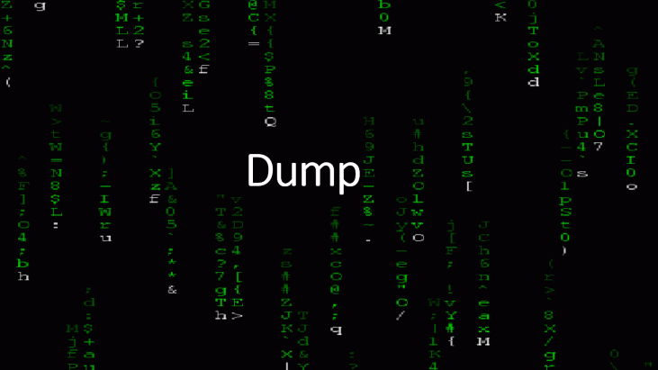
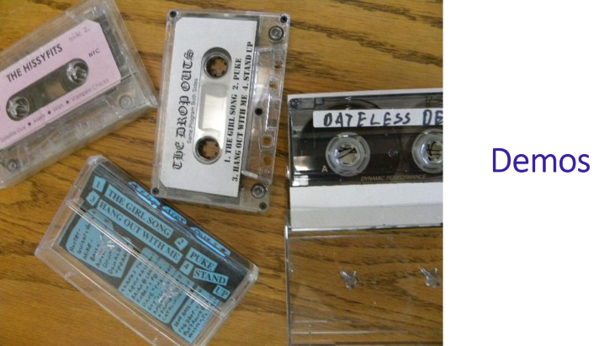
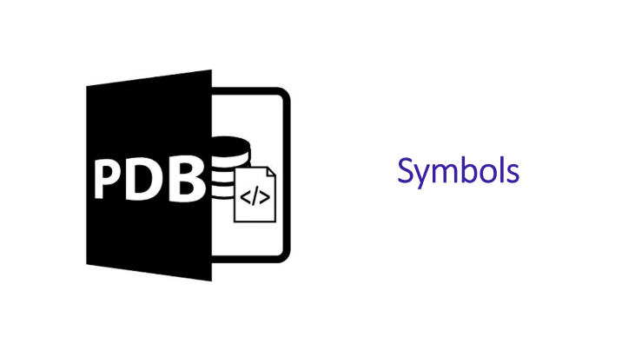
Agenda

Slide 3
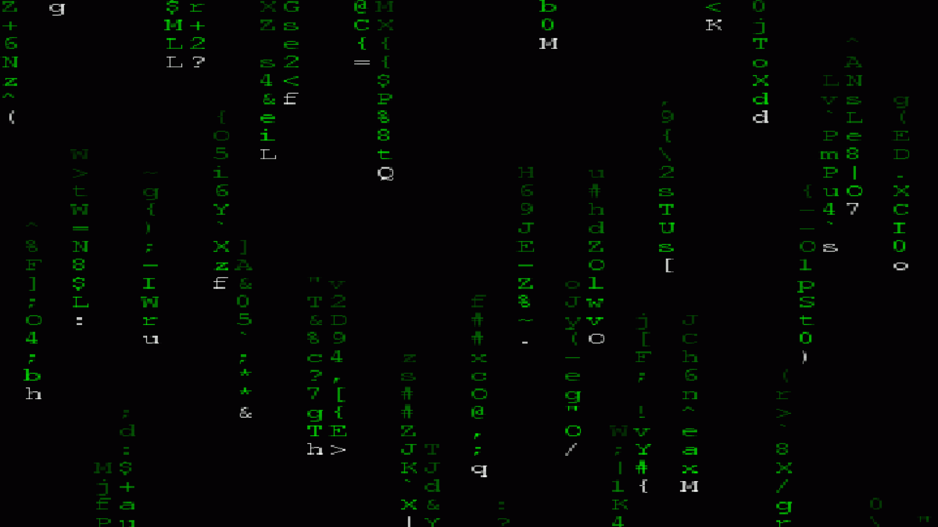
Dump

Slide 4
Production problem
Memory leak
High CPU demand
Constant crashes
And we can’t repro them!

Slide 5

Production problem
Memory leak
High CPU demand
Constant crashes
And we can’t repro them!

Slide 6
It is not possible to debug
Restricted or inaccessible environment
Performance impact

Slide 7
Memory dump to the rescue
Dumps are memory snapshots taken at some point in time
When you demand one
When the app crashed or hanged
Dumps bring along all application context
Environment variables
System information

Slide 8

Memory dump to the rescue
Dumps are memory snapshots taken at some point in time
When you demand one
When the app crashed or hanged
Dumps bring along all application context
Environment variables
System information

Slide 9

Dump can be taken in various ways
Task Manager
Process Explorer
ProcDump
Visual Studio
ADPlus
dotnet-dump
dotnet-gcdump
new

Slide 10
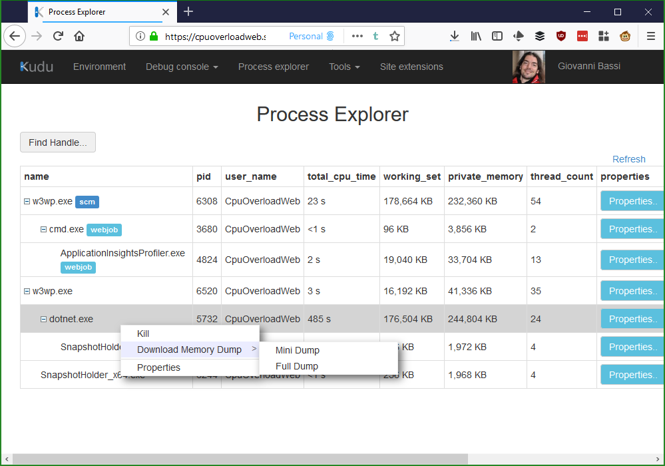
Creating a dump from Azure App Service

Slide 11
Creating a dump from Azure App Service

Slide 12
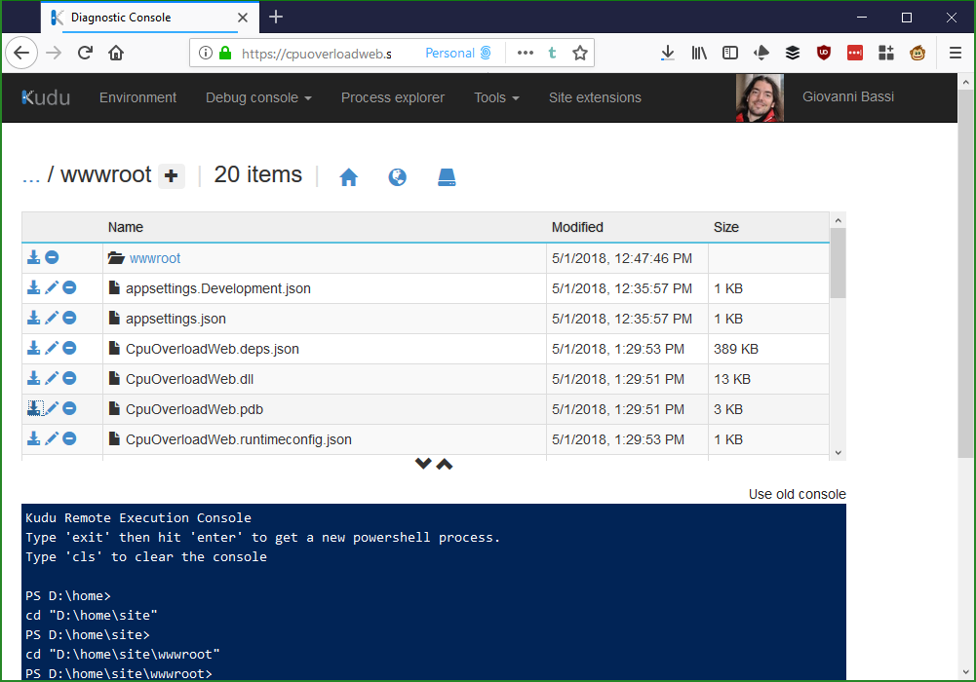
Downloading symbols

Slide 13
Downloading symbols

Slide 14
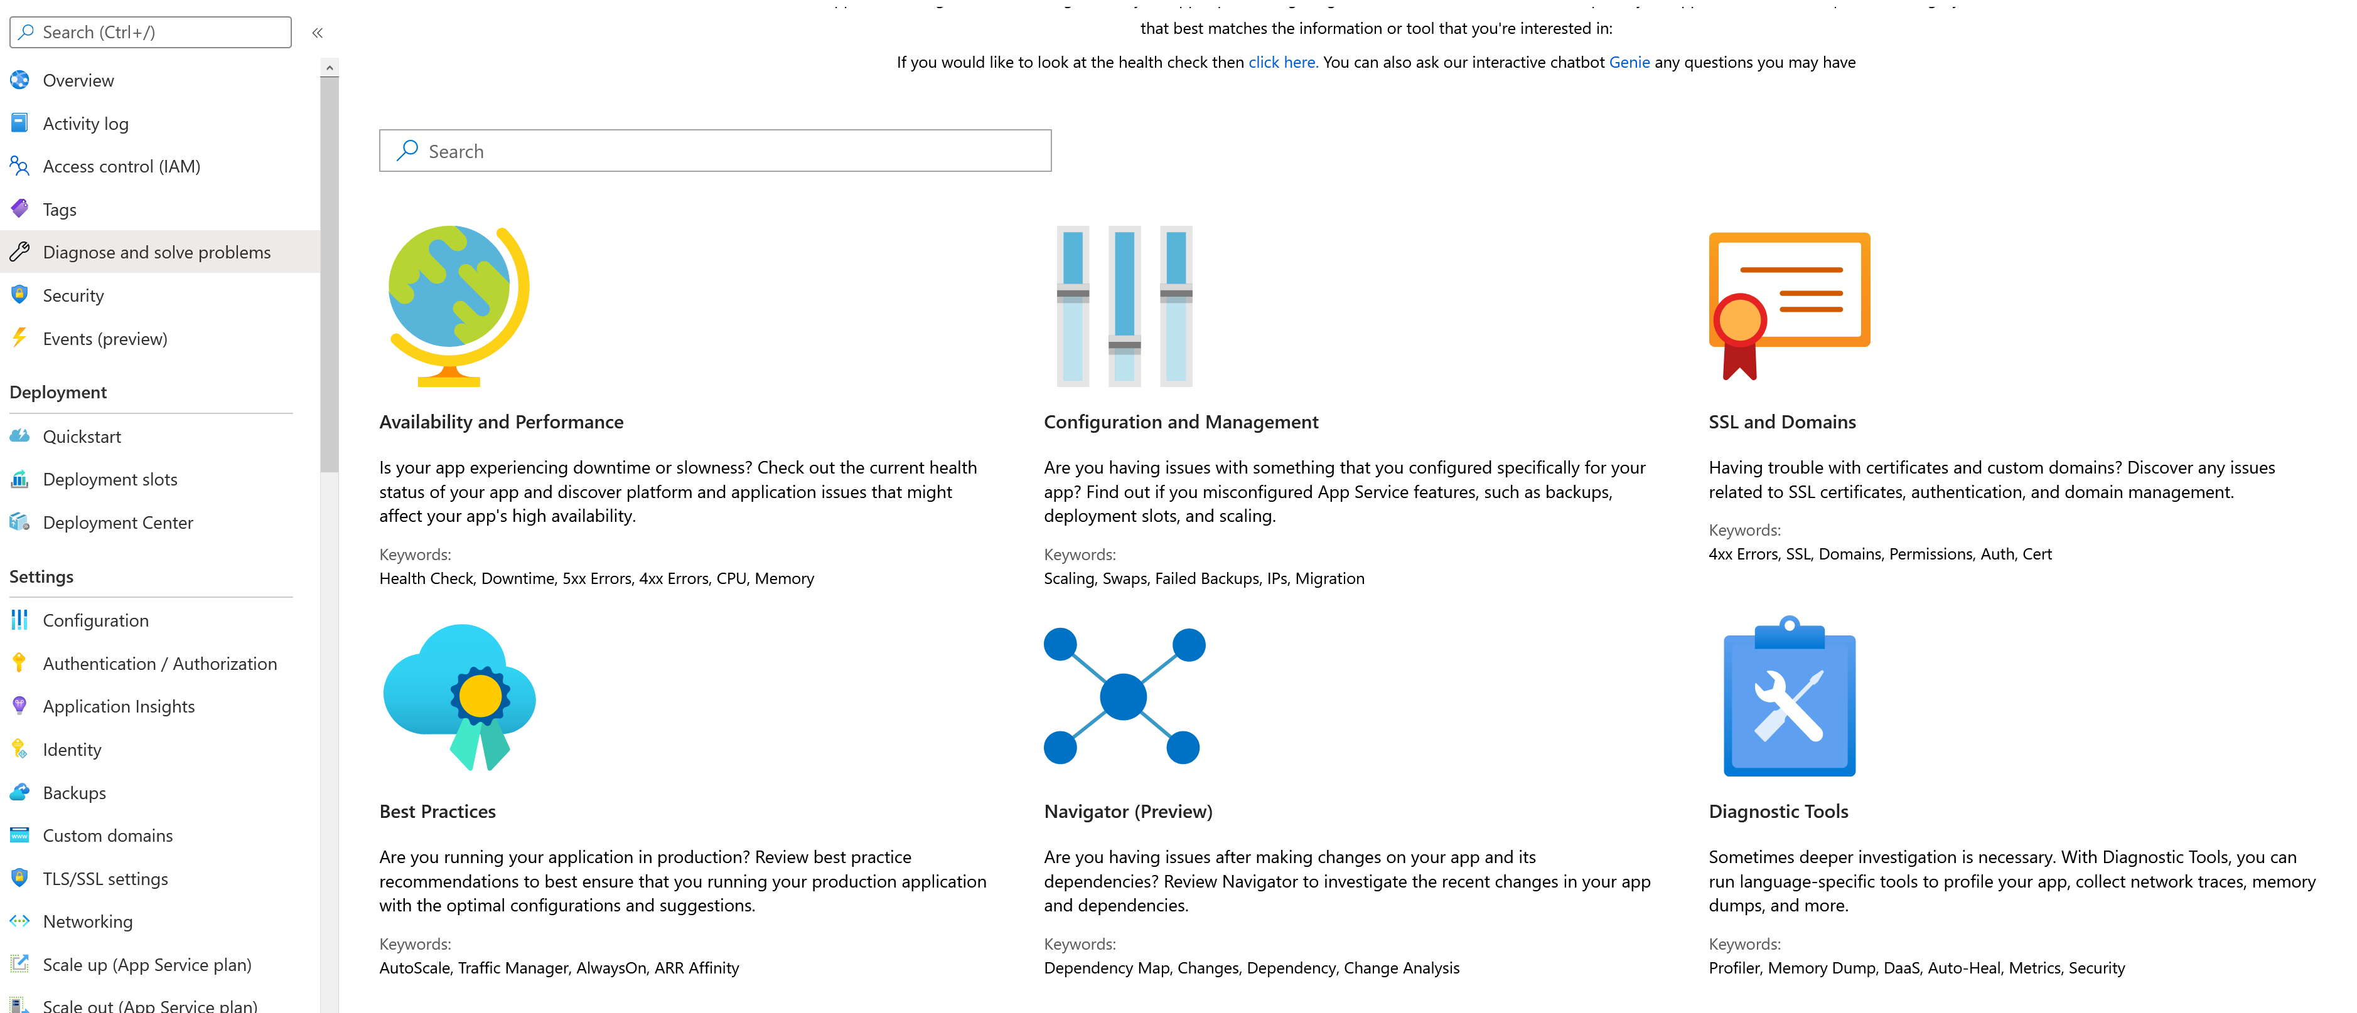
Creating a dump from Azure App Service

Slide 15
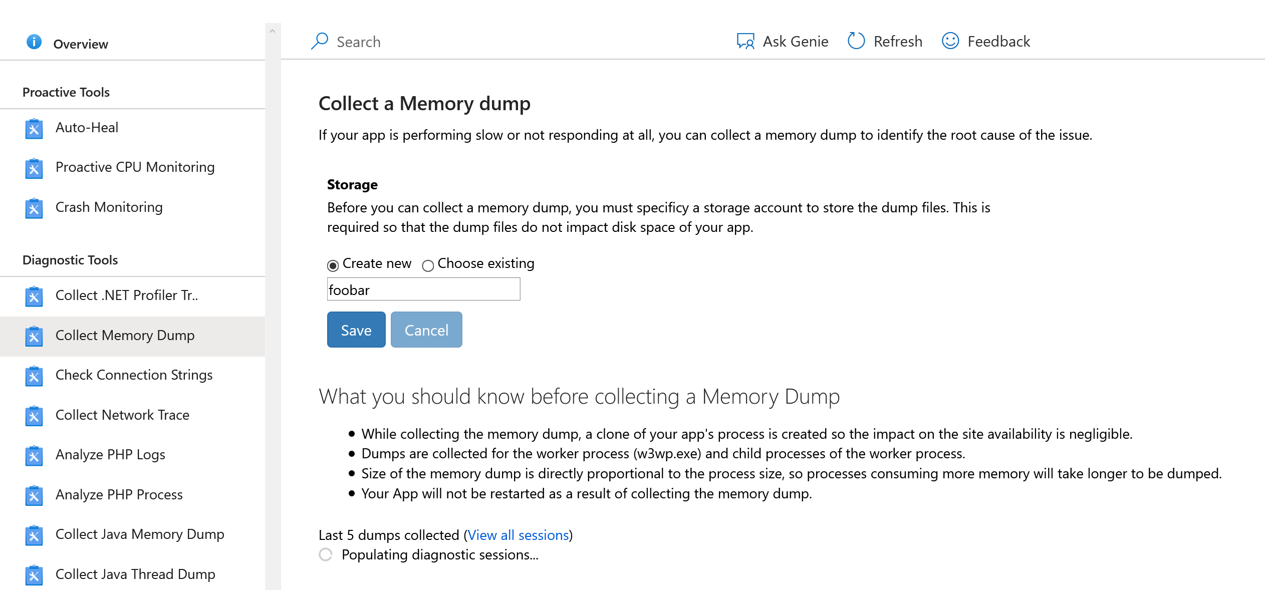
Creating a dump from Azure App Service

Slide 16
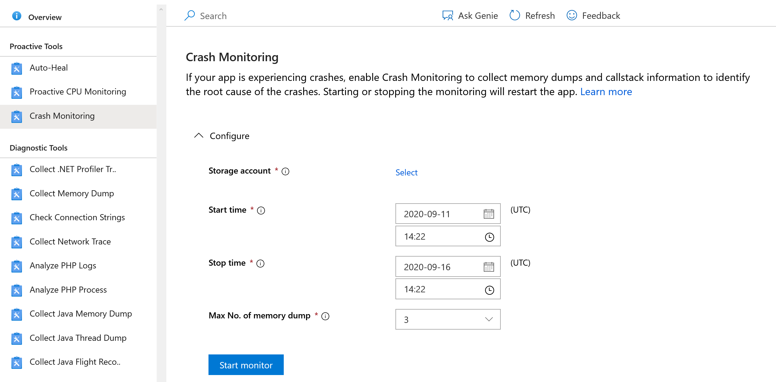
Creating a dump from Azure App Service

Slide 17
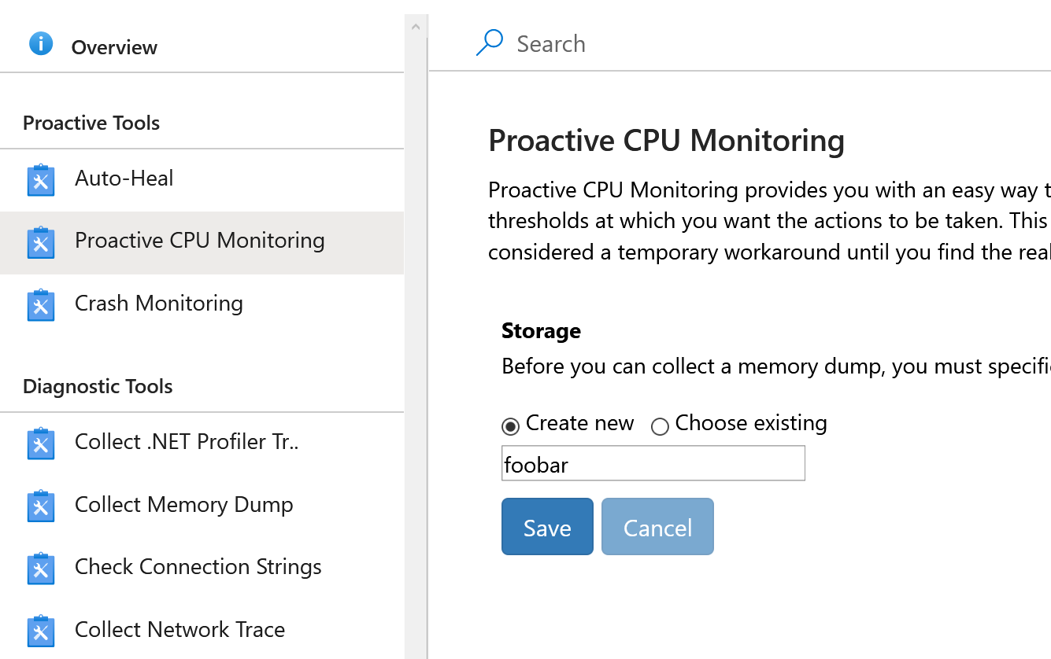
Creating a dump from Azure App Service

Slide 18
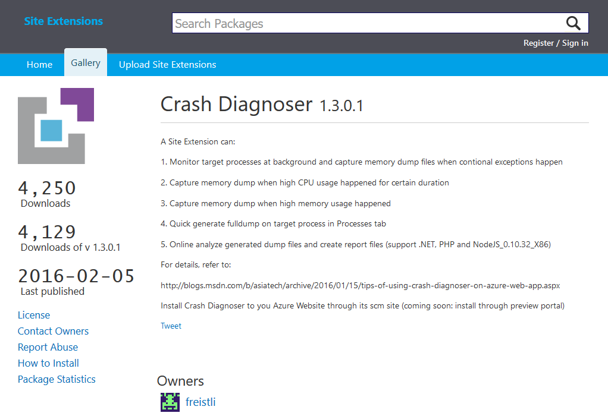
Crash Diagnoser extensions
https://www.siteextensions.net/packages/crashdiag/ https://www.nuget.org/packages/crashdiag/

Slide 19

WinDbg

Slide 20
Analyzing memory dumps
This analysis, in Windows, is historically made with WinDbg
WinDbg is an old, complex, non intuitive, advanced tool, but very powerful
It is now available on the Windows Store, in a preview which is more modern and easier to use: bit.ly/windbgpreview

Slide 21
dotnet dump
.NET dump is a new tool that works only with .NET Core (and .NET), that allows to create and analyze dumps
Dumps can be created in one plataform and analyzed in another (Linux, Windows, Mac)
Dumps can be created with `dotnet dump` and analyzed on WinDbg

Slide 22
dotnet gcdump
Generates a dump file that is used to generate a report or open in PerfView or Visual Studio
Easier to use than usual dump analysis
Dumps are not compatible with usual memory analysis tools
Only available for .NET Core 3.1+
https://devblogs.microsoft.com/dotnet/collecting-and-analyzing-memory-dumps/

Slide 23
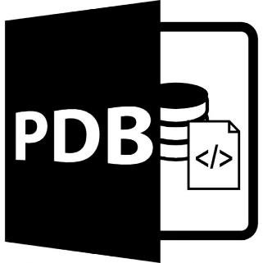
Symbols
Notes:
Imagem de https://www.freepik.com/free-icon/pdb-file-format-symbol_742252.htm

Slide 24
Symbols
Symbols connect memory dumps to code
There are app symbols and infrastructure symbols
Symbol servers are used to store symbols
Symbols take a while to download

Slide 25
Downloading symbols
WinDbg can download the symbols it needs
When using dotnet-dump you can use dotnet-symbol to download the symbols before starting the analysis session

Slide 26
Public symbols
Microsoft offers a symbols server where it hosts symbols for a lot of its products:
https://msdl.microsoft.com/download/symbols
For public symbol hosting there is also SymbolSource.org and Nuget.org
For private symbols there is Azure DevOps, MyGet, shared network folders and many other options

Slide 27
Private symbols
It is very important to store symbols, or it won’t be possible to effectively analyze dumps
Use continuous integration and a Symbol Server for your symbols
By default Visual Studio also publishes symbols
Azure DevOps offers a way to store symbols
It is possible to download symbols from Azure App Service

Slide 28
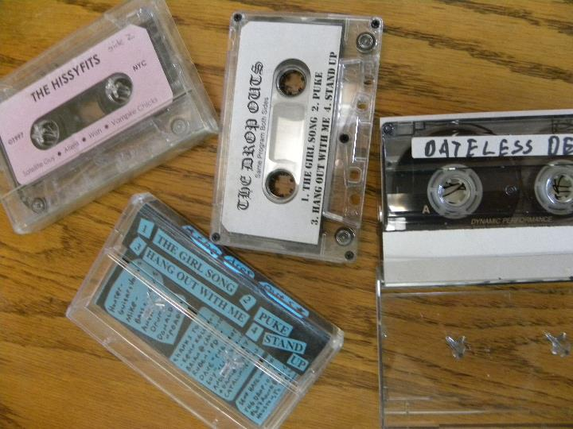
Demos
Notes:
Imagem de https://www.freepik.com/free-icon/pdb-file-format-symbol_742252.htm

Slide 29
Demo
Memory Leak
ASP.NET Core

Slide 30
Demo
dotnet dump

Slide 31
References
dotnet-dump docs: bit.ly/dumpdocs
Crash Diagnoser: bit.ly/crashdiag2
WinDbg Preview: bit.ly/windbgpreview
Sysinternals: sysinternals.com

Slide 32

Questions?
@giovannibassi

Slide 33

Thanks for joining!
@giovannibassi

